Slide 1
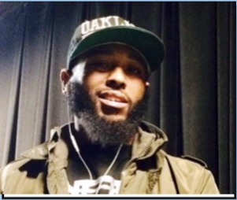




A02 Tiger Olis Bahari ITAI1370 2026 Summer
Anthropic Organization & Patent Assignment
V5.0
Eric
Jose
Tyyotalle
Olis

Slide 2
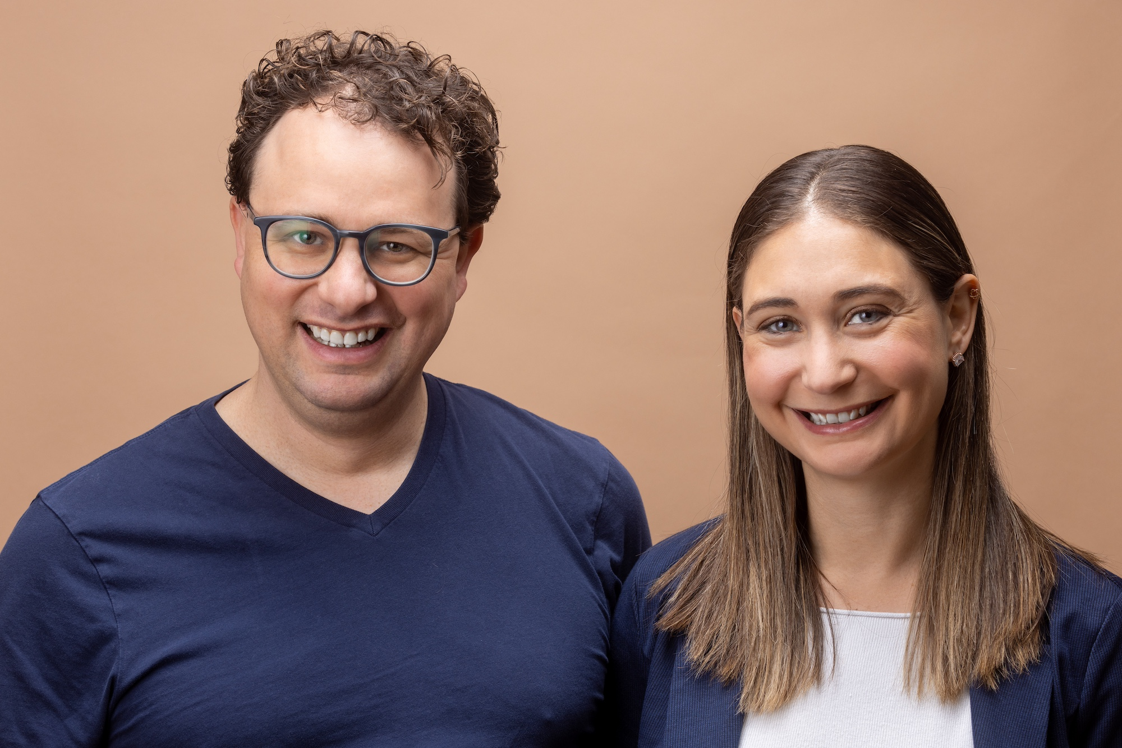
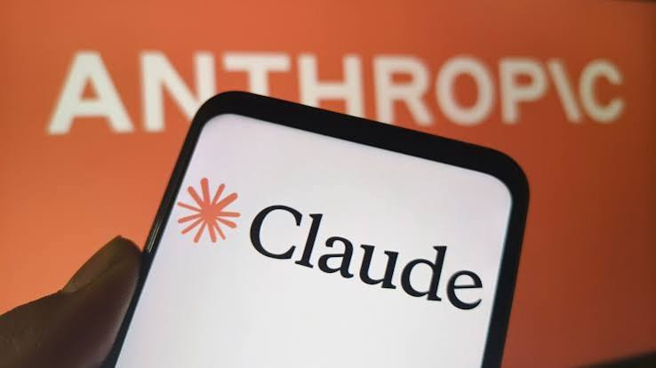
Anthropic Organization
Anthropic was founded by several former OpenAI employees, including two brothers and a sister who took leadership roles at the company.
Anthropic's flagship product, Claude, is one of the largest language models in the world. There have been various reports on its use, and concerns exist regarding its application in sensitive settings. The company is worth close to one trillion dollars and is privately held.
Anthropic asserts a commitment to public safety and security, while concerns remain regarding external pressures facing the organization.
There have been claims that Anthropic's main customers include the US military and contractors, with suggestions that ongoing conflict impacts their sales.
There are allegations that Anthropic has used books without permission, and reports suggest it faced legal cases, including a large settlement.

Slide 3
Anthropic: History, Products, and Recent Developments
Anthropic is an artificial intelligence company founded in 2021 by former OpenAI researchers, including Dario Amodei and Daniela Amodei. The founders created the company because they believed AI development should place a stronger emphasis on safety, transparency, and alignment with human values. Unlike many technology startups, Anthropic was organized as a Public Benefit Corporation (PBC), meaning it is legally required to consider public benefits in addition to shareholder interests.
One of Anthropic's most important contributions to the AI industry is its development of Constitutional AI. This approach trains AI systems using a set of guiding principles designed to encourage helpful, honest, and safe behavior. Constitutional AI became the foundation for Anthropic's Claude family of models.
Anthropic's most significant products include Claude, its conversational AI assistant, and the Claude family of large language models. The company has released several generations of Claude, including Claude 2, Claude 3 Haiku, Claude 3 Sonnet, Claude 3Opus, and later Claude 3.5 and Claude 4 models. Anthropic has also expanded its developer platform through APIs and coding-focused tools such as Claude Code, allowing businesses and software developers to integrate AI into their applications and workflows

Slide 4
Anthropic: History, Products, and Recent Developments
In recent years, Anthropic has become one of the leading AI companies in the world. Major investments from companies such as Google and Amazon have helped accelerate its growth and research efforts. The company has also expanded partnerships with businesses, educational institutions, and technology providers that use Claude for customer support, software development, research, and productivity tasks.
Recent news surrounding Anthropic has focused on new Claude model releases, AI safety research, business partnerships, and ongoing discussions about AI regulation and copyright law. As governments and organizations continue debating how advanced AI systems should be governed, Anthropic has remained an influential voice advocating responsible for AI development and safety-focused research.
Overall, Anthropic's history demonstrates how concerns about AI safety helped shape the creation of a company that now plays a major role in the global artificial intelligence industry. Its emphasis on responsible development, combined with rapid technological innovation, has made it one of the most important competitors in the modern AI market.

Slide 5
Anthropic: History, Products, and Recent Developments
References:
https://www.cnn.com/2026/06/21/tech/anthropicairegulation
https://www.bloomberg.com/news/articles/2026-06-19/nobel-winner-john-jumper-to-leave-googledeepmind-for-anthropic
https://www.britannica.com/money/Anthropic-PBC

Slide 6
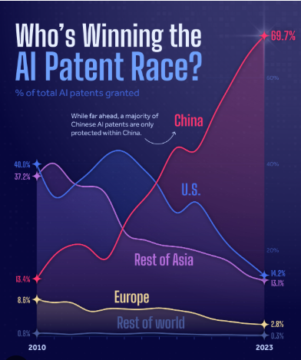
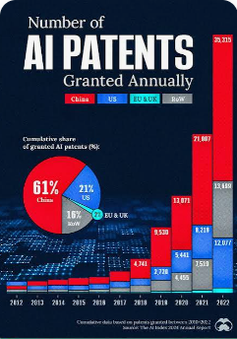
AI Patens
This document includes two graphs: one showing global patent counts and another showing the rise in AI patent counts. China has overtaken the US and other countries in AI patent filings, underscoring its strong recognition of AI's current and future importance.
Patent numbers in the US, Asia, Europe, and the rest of the world are decreasing annually. The rest of the world is nearing zero, suggesting they will be consumers rather than producers of AI.

Slide 7
AI Patens
Anthropic has a total of 39 patents globally, out of which 30 have been granted. Of these 39 patents, all the patents are active. The United States of America is where Anthropic has filed the maximum number of patents, followed by Germany and Australia.
IBM, Microsoft, and Google are the top patent holders in the AI domain with 3594, 2207, and 1174 patent families respectively. This depicts that the USA holds the largest AI patent portfolio.

